Slide 1
Boeing Drone: 100% Build Update
Project 03
Team Hi-Jacks
Damien Brothers, Dante Faria, Jay Khunt, Colby Murphy, and Thomas Schreiber

Slide 2
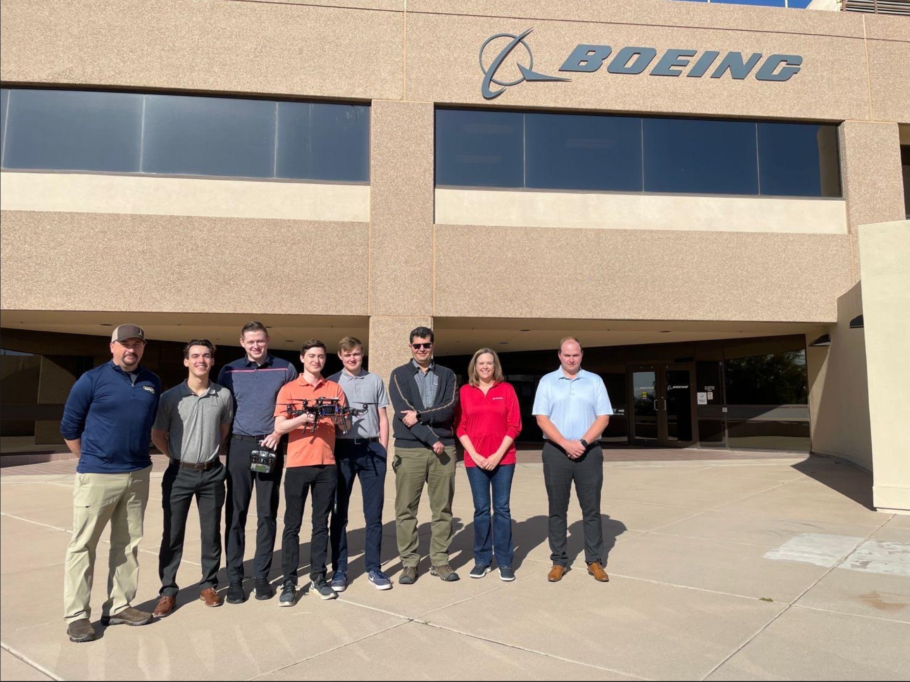
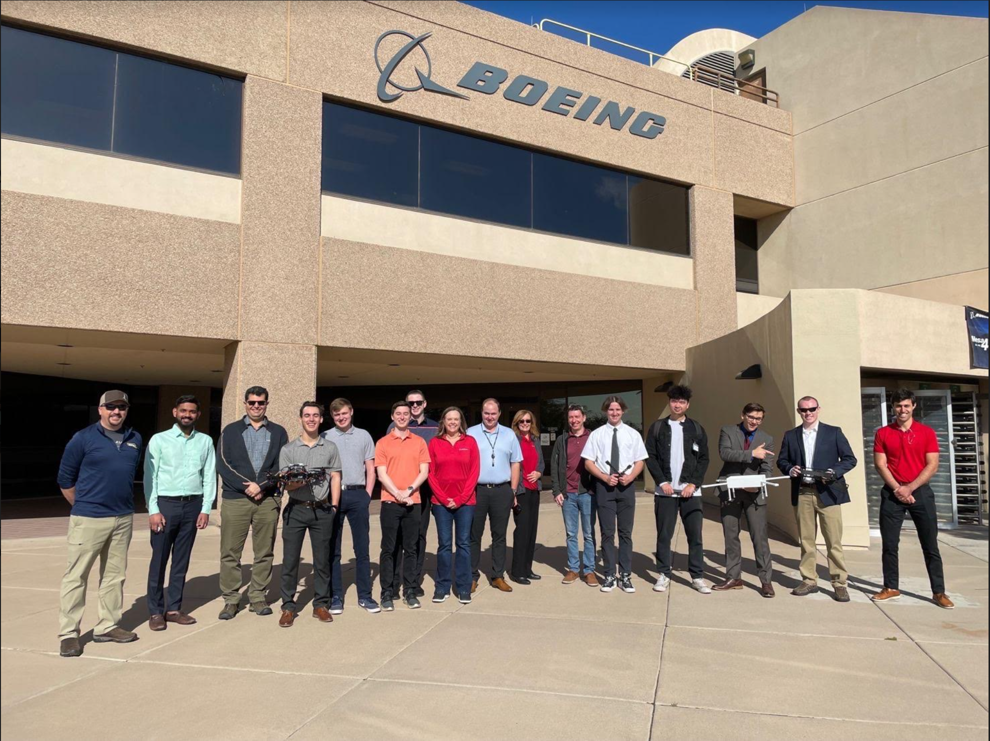
Project Recap
Boeing visit was successful.
Drone was functional.
Clients and Boeing engineers were very pleased.
Damien, 2

Slide 3
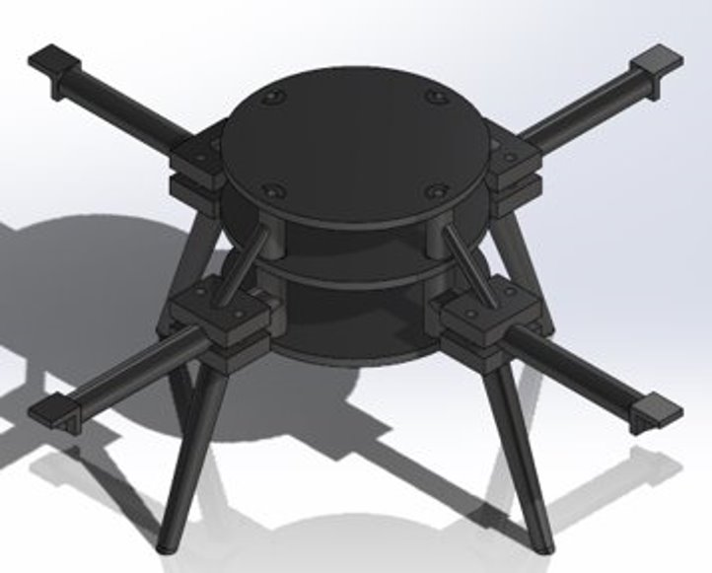
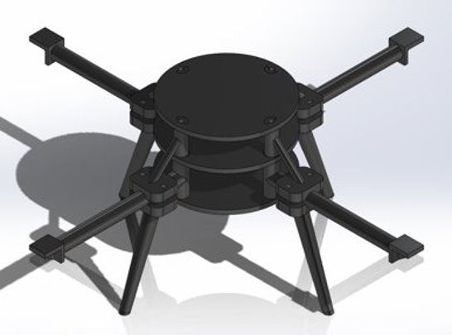
Design Efforts
Start of Semester:
33%:
Short arms
Sharp edges
Extended arms by 1”
Fillet sharp edges
Tommy, 3

Slide 4
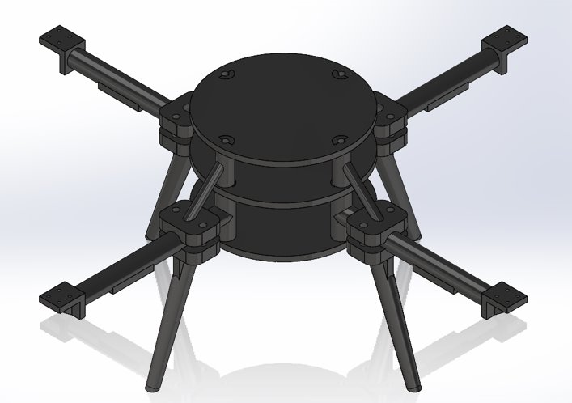
Design Efforts
67%:
100%:
Decreased arms by 0.5"
Mounts
Screw holes
Same design with new, stronger materials
Tommy, 4

Slide 5
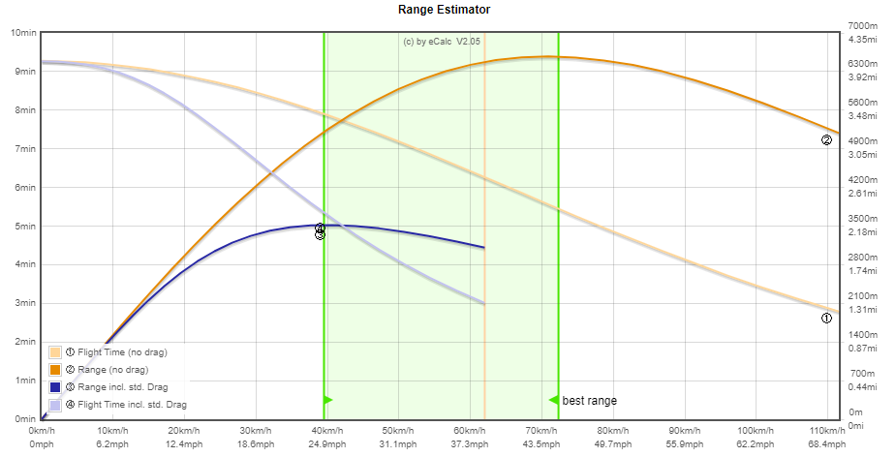
Early Testing
We used eCalc on our 67% build to gain insight on how our final version might perform
Unsure on final weight
±15% accuracy
Tommy, 5

Slide 6
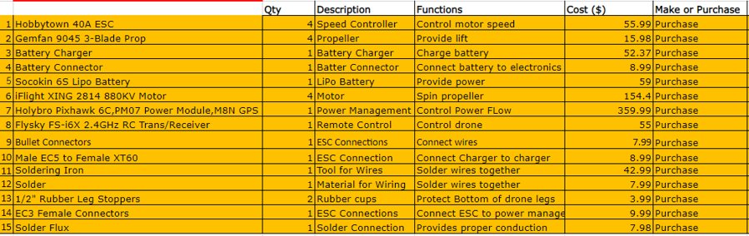
Purchasing Plan
All parts are ordered, delivered, and on hand (Nov 2022)
3D printing has been completed as of 4/5/2023
Current budget- $3100 remaining
Time for a paint job (Out of pocket)
Colby, 6

Slide 7
Manufacturing Plan
Manufactured (3D printed Final Design):
  Plates
  Legs
  Arms
  Spacers and Connectors (Trusses)
Assembly line:
  Finished with all electrical connections
  Connection of all 4 motors, power management board, Battery, and GPS is done to flight controller. (Parts require for manual flight)
Yet to do (Final Design):
  Paint Job
Jay, 7

Slide 8
Manufacturing Plan
Part​ | PCS.​ | Item No​ | Item Description​ | Weight [g]​ | What​ | Where​ | Cost ($)​
1​ | 3​ | 22F-001​ | ABS 3D Printed Plate W/ Key​ | 183​ | ABS | IDEA Lab​ | 88.8
3​ | 4​ | 22F-003​ | Carbon Fiber infused ONYX 3D Printed Arm W/Spacer​ | 108​ | ONYX (carbon infused)​ | IDEA Lab​ | 146.34
4​ | 4​ | 22F-004​ | ONYX 3D Printed Leg W/Arm Clamp​ | 76​ | ONYX​ | IDEA Lab | 119.08​
5​ | 4​ | 22F-005​ | Carbon Fiber infused ONYX 3D Printed Spacer W/Arm Clamp​ | 60​ | ONYX (carbon infused) | IDEA Lab | 49.31 ​
Drone was designed for easy fixes
Team has completed final design 3D print
New Arms and Truss are reinforced with Carbon fiber on Final Prototype ($)
Jay, 8

Slide 9
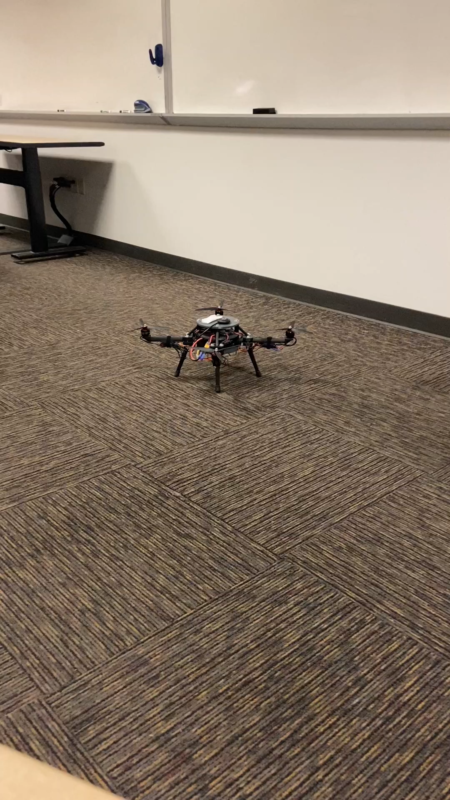
Demonstration
Flight is about the same as 67%
  Adjusted more controller settings to ensure stable flight
  Better CG (Center of Gravity)
Issues:
  Intermittent wobble
  Power/Throttle issues causing drone to rise into the air unexpectedly
Damien, 9

Slide 10
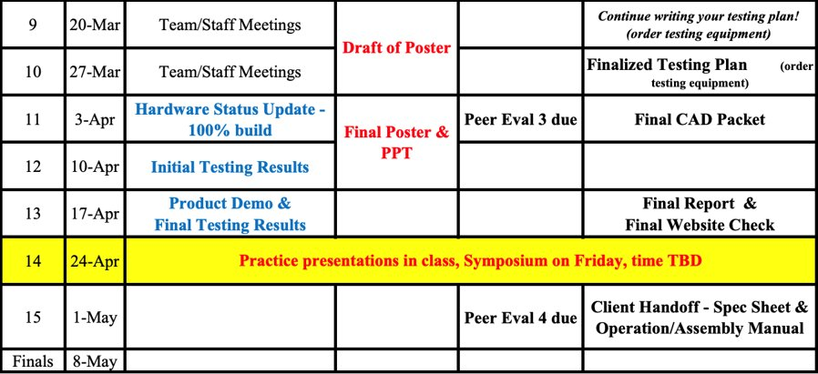
Gantt Chart Update
On Schedule (98% Build)
Successful Boeing Visit
Website needs a few updates
Final CAD Drawings and BOM are almost complete
Ecalc Analysis Complete
Initial Testing Results on the way
Dante, 10

Slide 11
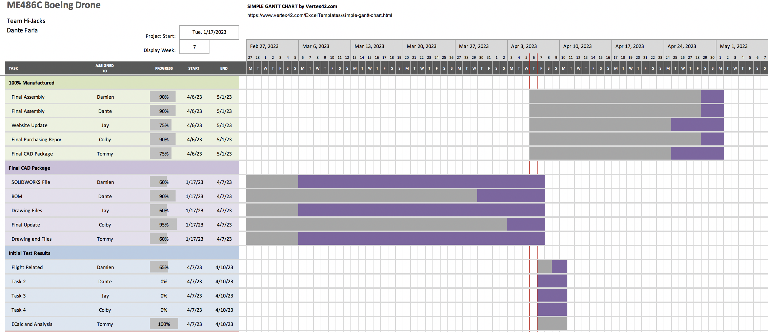
Gantt Chart Update (Future)
Dante, 11

Slide 12
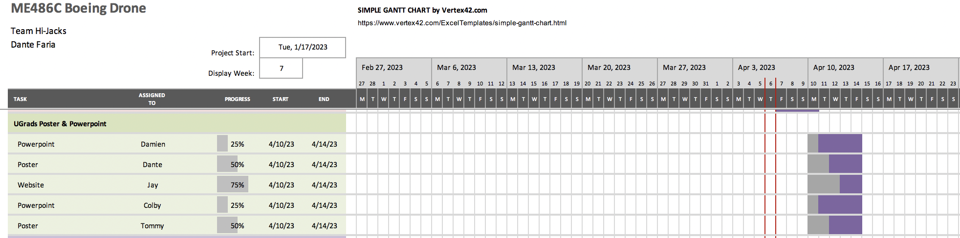
Gantt Chart Update (Future)
Dante, 12

Slide 13

Questions??

